Slide 1
NICO FOR NEWCOMERS
How to start from scratch
branislav.zigo@fmph.uniba.sk
5.3.2025

Slide 2
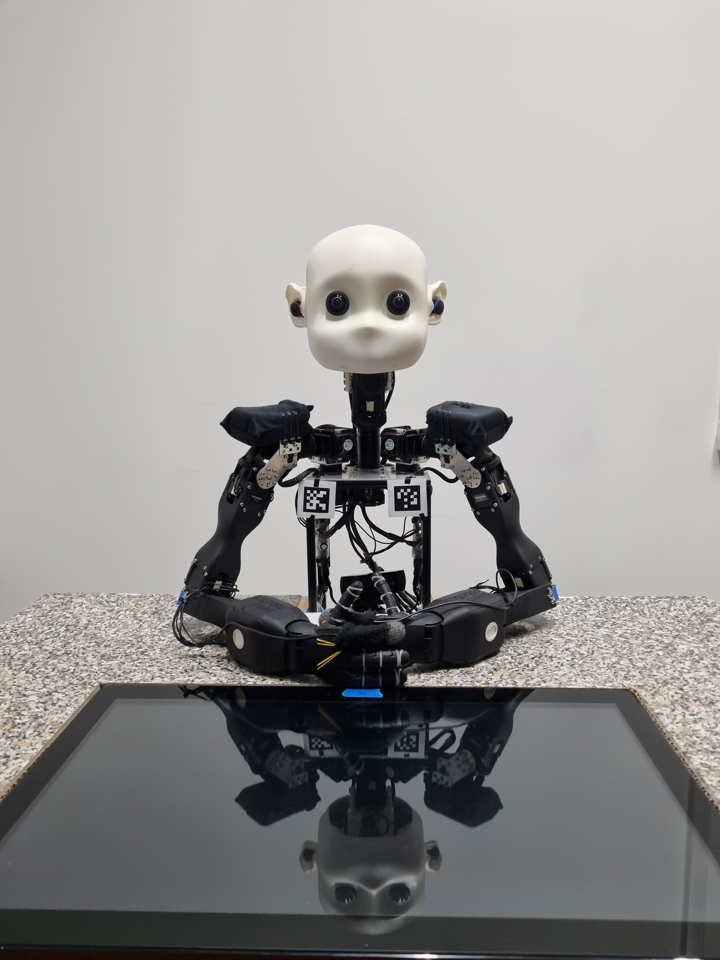
NICO for beginNers
The purpose – fast ramp-up
The obstacle No.1 – missing proper documentation and training material
The task – prepare the documents for beginners to be able to work with NICO quickly and without frustration
The solution – tutorial, user guide, set of initial and testing scripts, repository for beginers
I would like to thank to all colleagues providing necessary information!

Slide 3
Target audience
Undergraduate students and people without practical knowledge about robotics
Prerequisities
Basic knowledge of Python
MS Windows or Linux (Windows preferred)
Assumptions
Work in Windows environment
Work with own notebook
Goal
To be able to start to work with NICO within one day
To be able to perform the installation and initial tests with minimal supervision

Slide 4
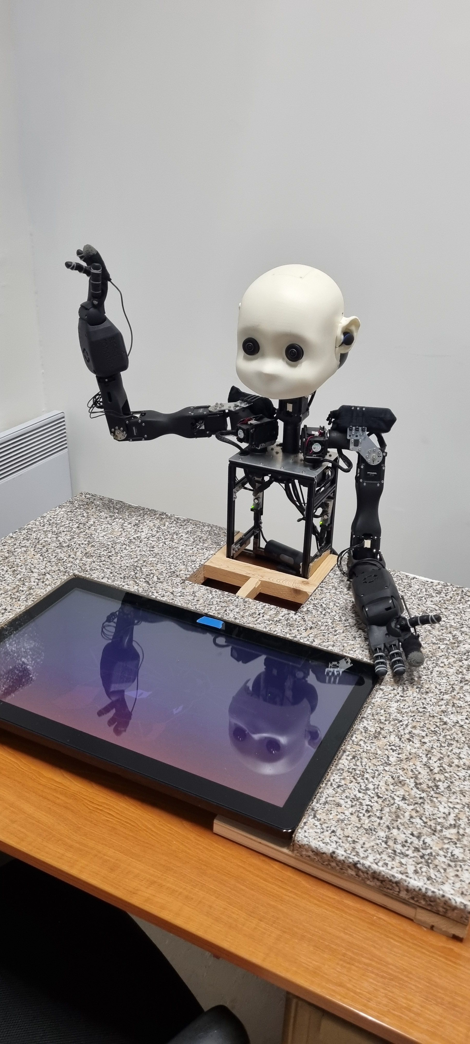
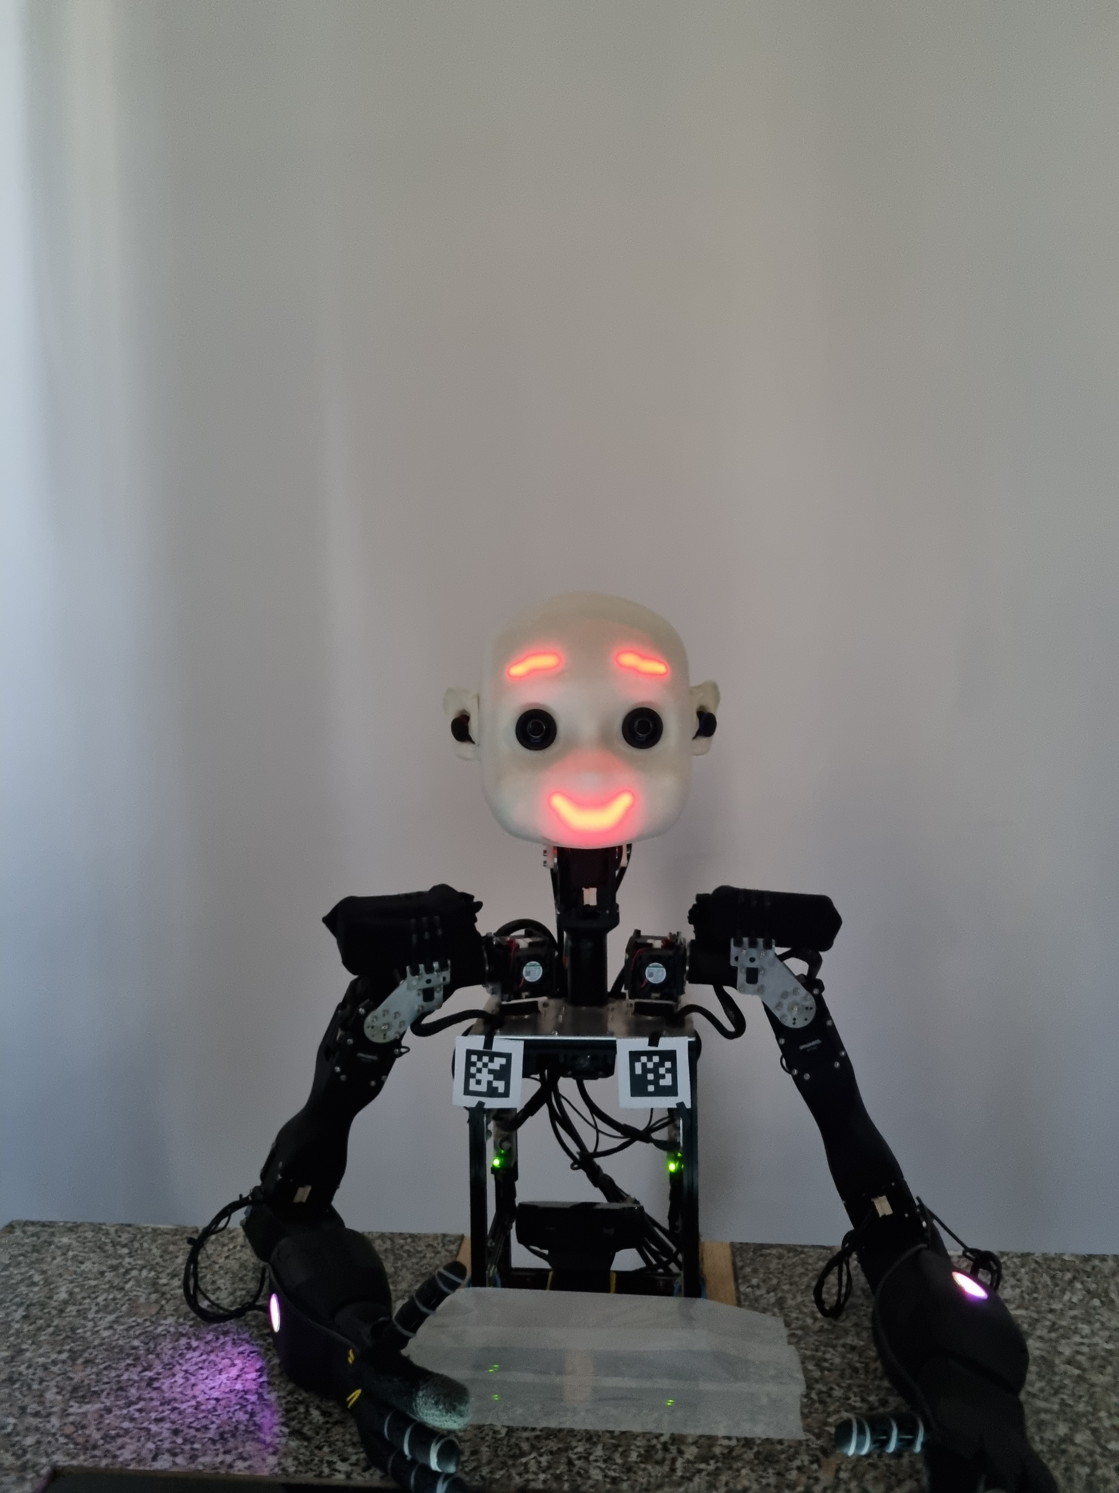
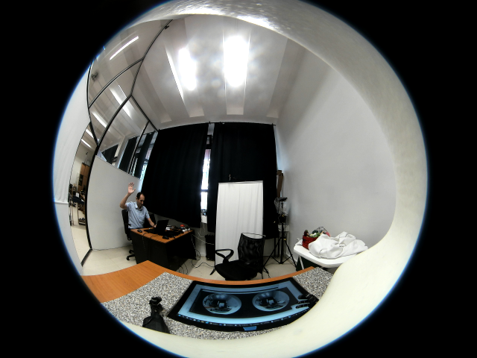
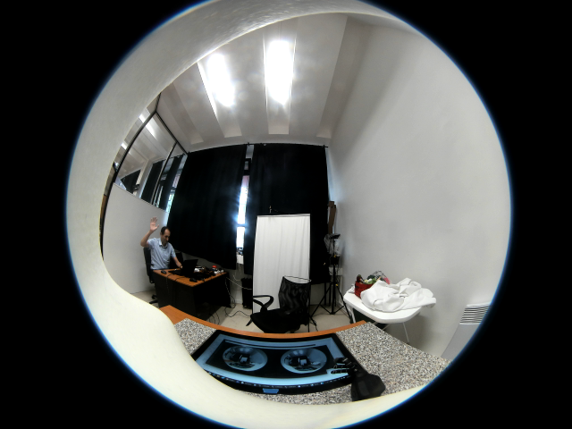
Repository
GitHub - https://github.com/branozigo/NICO-robot---tutorial/tree/main
NICO robot tutorial
Installation manual
List of known issues
Simple Python scripts
Port settings and interconnection
Facial expression
Camera control
Basic movements

Slide 5
Approach
Explanation of NICO HW and SW
Installation of Python – optionally in virtual environment
Installation of necessary packages
Interconnection of NICO and notebook - check for used ports
Checking basic communication – NICO mimic
Work with camera, speakers and microphone
Work with motors (Dynamixel, pypot, nicomotion package)

Slide 6
results
First release of documentation is prepared
Tested on few volunteers
Thorough testing and fine-tuning necessary

Slide 7
Thank you for your attention!

